Slide 1


Talend For Data Integration
Working with databases
Working with internet components
AUTHOR: SERGEY MOUKAVOZTCHIK
January, 2018

Slide 2
AGENDA
Working with databases
Creating database metadata
Database connections
Defining DB in metadata repository
CRUD operations
Using parameters inside SQL queries
ELT
Working with internet components
FTP
Accessing a web service
email

Slide 3
DB COMPONENTS
Connection management:
tOracleConnection
tOracleClose
CRUD operations:
tOracleInput
tOracleOutput
Transaction management:
tOracleCommit
tOracleRollback
Custom queries and SPs:
tOracleRow
tOracleSP
And others…

Slide 4
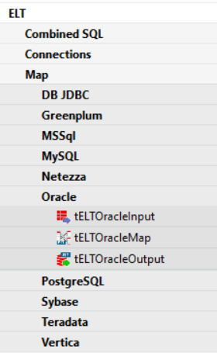
ELT
tELTOracleInput
Holds the metadata info
tELTOracleMap
Used to define joins and transformations
tELTOracleOutput
Define how we perform an output

Slide 5
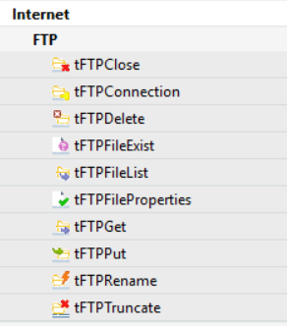
Working with internet components
FTP components
Some of them similar to File components
But Input and Output substituted with Put and Get
Connection could be set up and closed once per job like in DB components

Slide 6
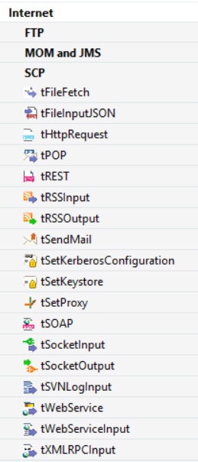
Working with internet components
Accessing a web service:
tFileFetch
tHttpRequest
tRest
and etc.

Slide 7
Working with internet components
tSendMail component:
Send email message via SMTP
EPAM SMTP host: owamsq.epam.com port: 25

Slide 8

USEFUL LINKS
Videos of webinar similar to this course can be found at:
https://videoportal.epam.com/search/results?q=Talend+DI
Also, here is a list of useful blogs and sites about Talend:
https://community.talend.com/
(pay attention to Tutorials: https://community.talend.com/t5/custom/page/page-id/Tutorials)
https://www.talendforge.org/
https://www.talendbyexample.com/
https://sites.google.com/site/bekwam/home/talend
http://www.vikramtakkar.com/
(https://www.linkedin.com/pulse/20141101170336-15611760-talend-certification-frequently-asked-questions-faq/)
http://talendhunter.blogspot.com.by/
http://www.robertomarchetto.com/category/blog/talend
http://blog.wdcigroup.net/blog/tag/talend/

Slide 9
Thanks for your attention!
Any questions?
AUTHOR: Sergey Moukavoztchik
Lead Software Engineer
January, 2018

